Slide 1
A Comparative Study between different data breaches and Capital one data Breach
Sheikh Abdul Wahid
M. Talha Munir

Slide 2



Introduce the era
Motivation in order to achieve something in the form of reward
Complete Secure as a thought
The ability of human to make secure and break that security at the same time

Slide 3
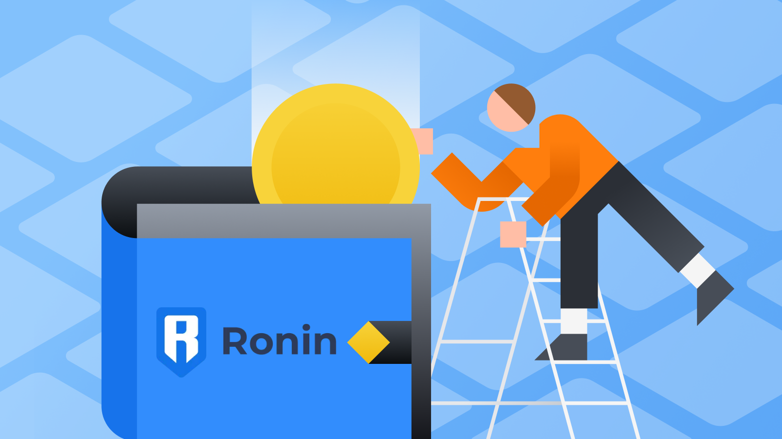



Different Case Studies
The picture represents different companies that were victims of data breaches

Slide 4
MediBank: October 2022
How Did It All Happen?
What Are the Consequences
Health insurer MediBank revealed on 10/25/2022 that almost 4 million of their customers’ data had been exposed to a hacker. The Australian health insurer said the personal information that could have been obtained includes name, address, date of birth, and even insurance card numbers.
In order to make things right, MediBank said it would offer compensation to those who were taken advantage of due to their private information being accessed. The estimated cost of this cyber attack to the company is between $25M and $35M.
They have since conducted an investigation and added more network monitoring and determined the hacker is no longer present.

Slide 5
Aadhaar Data Breach: 2018
How Did It All Happen?
What Are the Consequences
The Aadhaar breach is the perfect example of a massive cybersecurity incident if ever there was one. The world’s largest ID database, Aadhaar, was established by the Unique Identification Authority of India in 2009. The database contained information on more than 1.1 billion Indian citizens, including a 12-digit unique identity number, fingerprint scans of all 10 fingers, two iris scans, name, gender, and contact information.
The news of the Aadhaar database being hacked broke in January 2018, making the biggest data breaches of 2018
The utility provider is connected to the government database through an application programming interface that allows applications to retrieve data stored by other applications or software. Regrettably, Indane’s API had no access controls. This left the company’s data vulnerable. And the data of its customers, too. And every Aadhaar card owner.
The database with information on 1.1 billion citizens had been sitting unprotected for years. In it were names, addresses, photos, phone numbers, and emails, as well as biometric data like fingerprints and iris scans. This turned out to be a credit breach too, since the database also held information about bank accounts connected with the unique 12-digit number
The extremely poor security measures deployed by UIDAI is likely to have ongoing catastrophic consequences. Virtually all Indian adults became potential victims of identity theft and other crimes stemming from it.

Slide 6
Yahoo! Data Breach:2013-2016
How Did It All Happen?
What Are the Consequences
According to data breach statistics, the largest data breach in history is the one that Yahoo! suffered for several years. Not only is it the biggest breach according to the number of affected users, but it also feels like the most massive one because of all the headlines.
In September 2016, Yahoo! notified the public that 500 million user accounts had been breached in a 2014 cyberattack. A state-sponsored actor was suspected to be behind the attack. Just three months later, the company came forward again, saying that it discovered another breach that had occurred in August 2013. At the time, Yahoo! estimated that 1 billion user accounts had been affected, making it one of the worst data breaches of all time.
They have since conducted an investigation and added more network monitoring and determined the hacker is no longer present.
Names, phone numbers, security questions and answers, as well as password recovery emails and a cryptographic value unique to each account were copied by the attackers.
Yahoo! has agreed to create a settlement fund worth $117,500,000 to compensate for the damage it caused American and Israeli users. Affected individuals can opt for at least two years of credit monitoring services that include identity-theft monitoring or a cash reimbursement ranging from less than $100 to a maximum of $358.80.

Slide 7
Uber: September 2022
How Did It All Happen?
What Are the Consequences
One of the largest companies in the world, Uber, discovered they were hacked in mid-September after the hacker announced in the companies Slack organization “I am a hacker and Uber has suffered a data breach” followed by several emojis. This caused the company to shut down its internal messaging service and engineering systems in order to get to the bottom of the incident.
The hacker also claimed it could hack into several of the company’s databases, including messaging data. Uber got in touch with law enforcement and found out the hacker compromised an employee’s account. Uber had dealt with a cyber attack in the past and didn’t report it, which led to a legal battle and thousands of dollars in fees. This time they were upfront and taking the precautions in hopes of avoiding a similar situation again.

Slide 8
Plex: August 2022
How Did It All Happen?
What Are the Consequences
An August data breach into Plex, a media server app used by millions, resulted in personal encrypted data of their customers being compromised; including passwords, usernames, and emails. Millions of people’s personal info being accessed can damage a brand’s trust for years to come.
Although the vulnerability was addressed and secured, Plex still is encouraging their customers to reset their passwords and enable multi-factor authentication. Again, this should be standard practice to protect yourself against data breaches in 2022.

Slide 9
Crypto.com Breach: January 2022
How Did It All Happen?
What Are the Consequences
The blockchain model has long been regarded as one of the most secure forms of transaction processing. However, this hasn’t stopped hackers from trying to compromise crypto-based transactions. This is evident in the January 17, 2022 attack that targeted 483 users’ wallets on Crypto.com.
As part of this hack, the perpetrators stole approximately $18 million worth of bitcoin and $15 million worth of Ethereum, plus other cryptocurrencies. This was primarily possible thanks to the hackers’ ability to bypass two-factor authentication and access users’ wallets. Another example of why using a password manager is so important.
Initially dismissing it as a mere ‘incident,’ Crypto.com later retracted their statement, confirming that money had been stolen and that affected users had been reimbursed. The company also stated that they had audited their systems and worked to improve their security posture.
Businesses must be aware of the risks associated with cryptocurrency theft. The best way to protect against this type of fraud is to ensure that all sensitive data is encrypted.

Slide 10



Slide 11
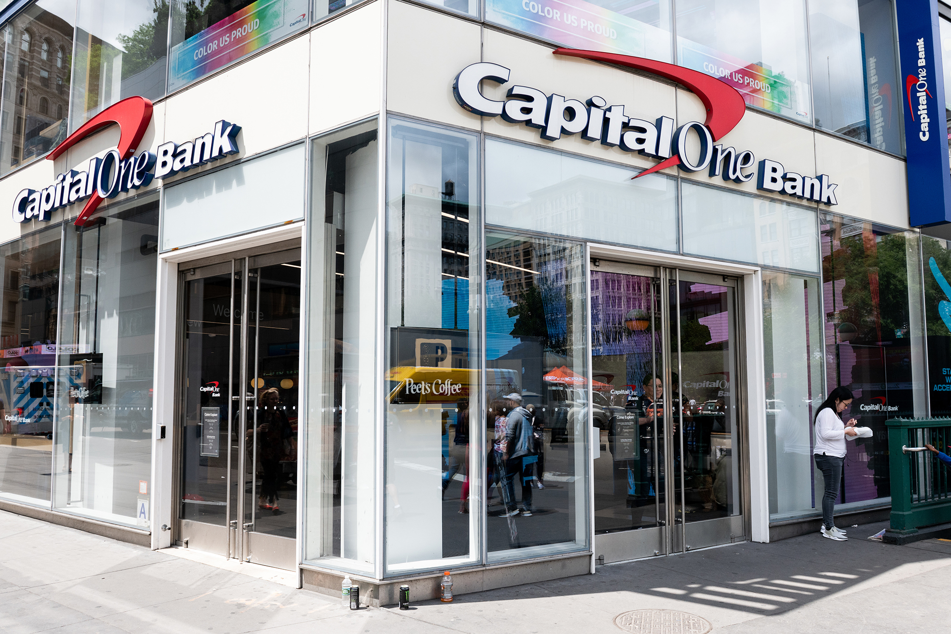
Capital One: 2019
On of the most high trading company
Different interesting offers
No minimum credit
Minimum Transaction fees
Unlimited Rewards
No Expirations
Travel Accident Insurance
Capital One Shopping
Total card purchases and withdrawals are limited to $5,000 per day.
All these offers made this corporation, way to the top in US.

Slide 12
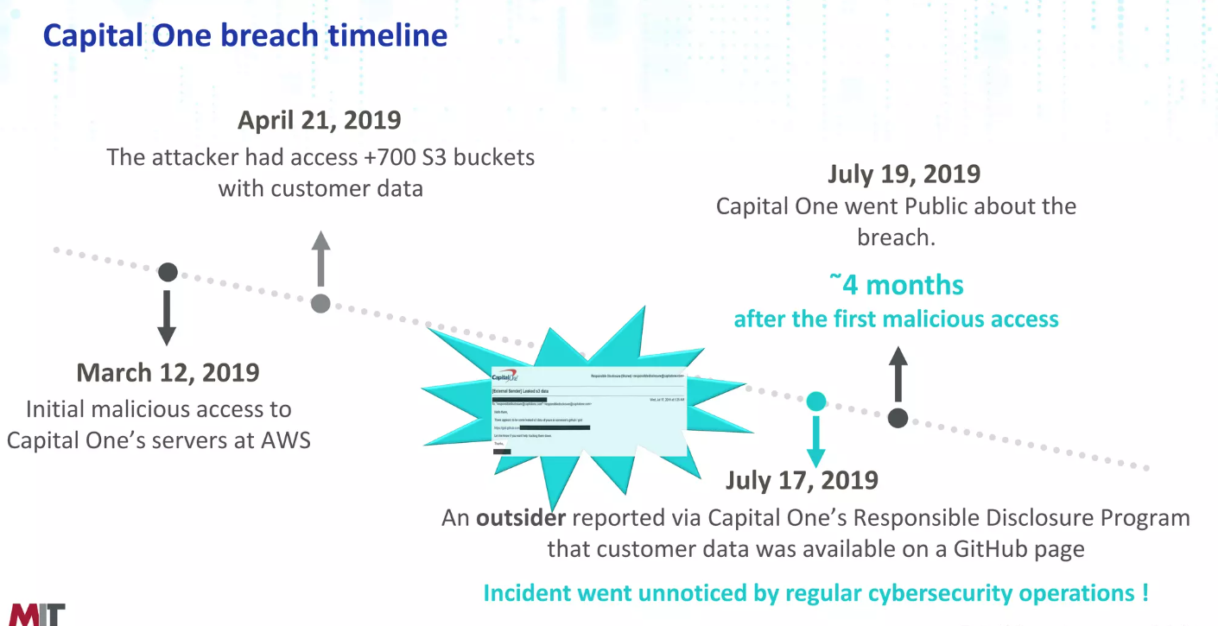
Capital One Data Breach: 2019
How Did It All Happen?

Slide 13
Capital One Data Breach: 2019
How Did It All Happen?
How Did It All Happen?
On 29th July 2019 CapitalOne Financial Corp announced a data breach affecting 140 000 of their customer's social security numbers and 80 000 bank account numbers. CapitalOne is a major user of AWS cloud, and in this case the stolen data was stored in AWS S3 buckets .
Since the perpetrator was arrested and left quite a long trail on social media, much more detail about this breach has become public than usual, allowing in-depth analysis of what went wrong.
Why didn't encryption save them?
Possible two ways
Configuring firewalls, IAM roles, VPCs and so on is complicated. It's not surprising that this occasionally leaves a hole. To protect against such eventualities most corporations require that all sensitive data stored in the cloud is encrypted. In the CapitalOne statement, they assert:
“We encrypt our data as a standard. Due to the particular circumstances of this incident, the unauthorized access also enabled the decrypting of data.”

Slide 14
Capital One Data Breach: 2019
How Did It All Happen?
How Did It All Happen?
One possible explanation is that, in this case, server-side encryption was used. This is the easiest way to comply with a requirement that cloud-stored data be encrypted: you just have to select an option in the AWS dashboard and AWS will generate a key, encrypt your data, and store the key for you. When you request the data back, AWS will transparently fetch the key, decrypt the data, and send it to you.
In the CapitalOne case, if this extra feature was in use, it seems like the same credentials allowed access to both. To address the shortcomings of server-side encryption you need to use what's called client side encryption, where the encryption key is managed by your own application, setting the bar far higher for a successful SSRF attack.
This is not just an AWS feature, all major CSPs offer this functionality (in GCP it happens automatically).This might protect you from some hypothetical insider at AWS who gets access to the raw data of your S3 bucket, but it doesn't protect you from the far more likely attack that happened to CapitalOne: a server-side request forgery or SSRF, where the attacker persuades the application to make a request under his own control. AWS (and other CSPs) offer an extra level of control on server-side encryption, where you can specify a particular key in their key-management service (KMS) that will wrap the data key for the S3 bucket.

Slide 15
Capital One Data Breach: 2019
How Did It All Happen?
To decrypt, you will need IAM permission to access the KMS as well as access the bucket. In the CapitalOne case, if this extra feature was in use, it seems like the same credentials allowed access to both. To address the shortcomings of server-side encryption you need to use what's called client side encryption, where the encryption key is managed by your own application, setting the bar far higher for a successful SSRF attack. The trouble is, client-side encryption is more complicated, imposing key-management responsibilities, requiring parameter choices that may have unintended consequences (see our recent article on AWS S3 Client-side encryption), and requiring a control at the application level to be sure its being used correctly.

Slide 16
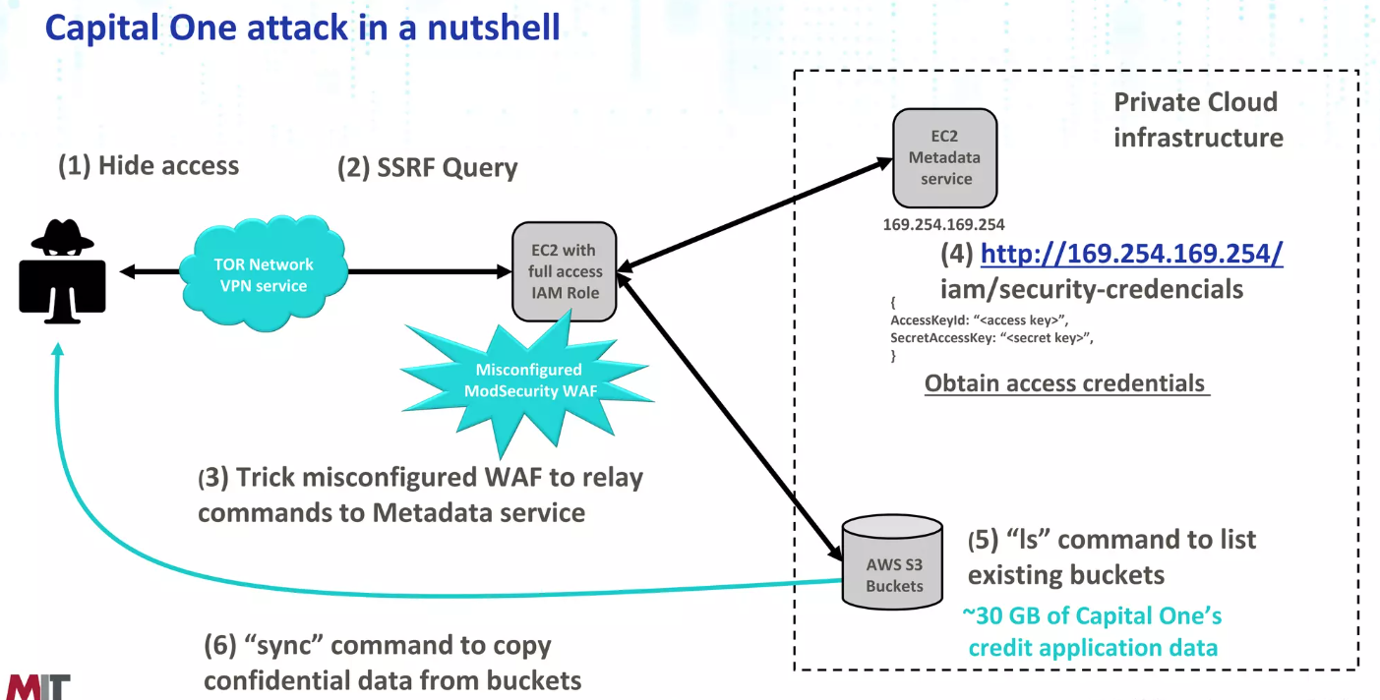
Capital One Data Breach: 2019
How Did It All Happen?

Slide 17
References
https://www.justice.gov/usao-wdwa/press-release/file/1188626/download
https://cryptosense.com/blog/the-capital-one-breach-and-cloud-encryption
https://www.electric.ai/blog/recent-big-company-data-breaches
https://www.justice.gov/usao-wdwa/pr/seattle-tech-worker-arrested-data-theft-involving-large-financial-services-company

Slide 18
Questions
Questions are always welcome because …

Slide 19
In the End, I would say
Thank You

